Slide 1
GoStrategic’s Business Leadership School

Slide 2
VISION of the Business Leadership School
Our mission is to train, mobilize, and deploy business people in the biblical principles of economics and marketplace practices.
The school is based on the inherent concept that deeper learning follows effective service to others
Effective leadership begins with our relationship to God, extends through our families, into our local churches and communities, and then into the nations.

Slide 3
STRUCTURE
SCOPE & COST: BLS is a two-year correspondence school divided into one-year courses, BLS100 ($395) and BLS200 ($895, scholarships available). Enrollment opens in January and classes begin in May each year. Payment plans are available for both years.
COMMITTMENT: Students are expected to attend monthly or bi-monthly meetings. Most groups are long distance and meet via conference call or webcast, though if there are enough people in your local area taking the course, you may meet in person. Each lesson is allotted two weeks for completion and takes about 2-3 hours total to read/listen to, process, and complete homework.
MENTOR-BASED: Students receive support from trained and screened BLS Facilitators who are, themselves, graduates of the course and have completed a special training school. The role of the Facilitator is to provide a level of direction, encouraging students and helping them to examine their thoughts, attitudes, and practices in light of the principles presented.
RELATIONALLY GROUNDED: Relationships are built through real-time group interaction. After studying the lessons and completing homework individually, participants meet with their assigned group and Facilitator for discussion. This model is founded out of our conviction that genuine transformation takes place in the context of spiritual relationships with other men and women.
INTENSIVE CONFERENCE: In the U.S., our annual conference (BLS Intensive) is held each spring. The event is open to all, but is a requirement for those continuing onto BLS200 (the second year of the BLS course). Those planning to enroll in BLS100 (the first year of the BLS course) are not required to attend an Intensive in advance. The goal of the Intensive is to inspire and envision attendees and to lay a foundation that will help prepare them for the course year.

Slide 4
CURRICULUM
BLS100 (Year 1) focuses on the fundamental differences between conventional economics and biblical economics.
Inheritance of the Heart (single audio teaching)
Doing Business God’s Way (book by Dennis Peacocke)
Worldview For The Marketplace (12-part audio series)
Building Spiritual & Organizational Dynasties (single audio teaching)
BLS200 (Year 2) focuses on strategic implementation of a biblical worldview. Prerequisites: 1) Completion of BLS100 with Facilitator oversight, and 2) BLS Intensive attendance
Good to Great (book by Jim Collins)
BLS200 Curriculum:
Section 1: The Foundations of Marketplace Ministry
Section 2: Establishing Our Spiritual Foundations for Building
Section 3: The Keys to Successful Business Life
Section 4: Solving Problems God’s Way
Section 5: Managing and Mentoring People with Destiny

Slide 5
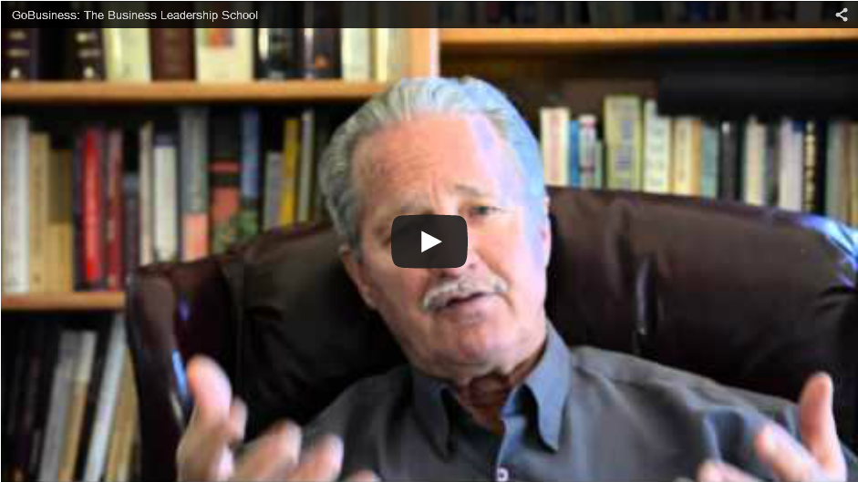
FOUNDER, DENNIS PEACOCKE
on the Business Leadership School
(click video to view online)

Slide 6
www.businessleadershipschool.org

